Slide 1
Economic Discipleship among Kibera Pastors An Exploratory Study
Doug Anderson
14 May 2015

Slide 2
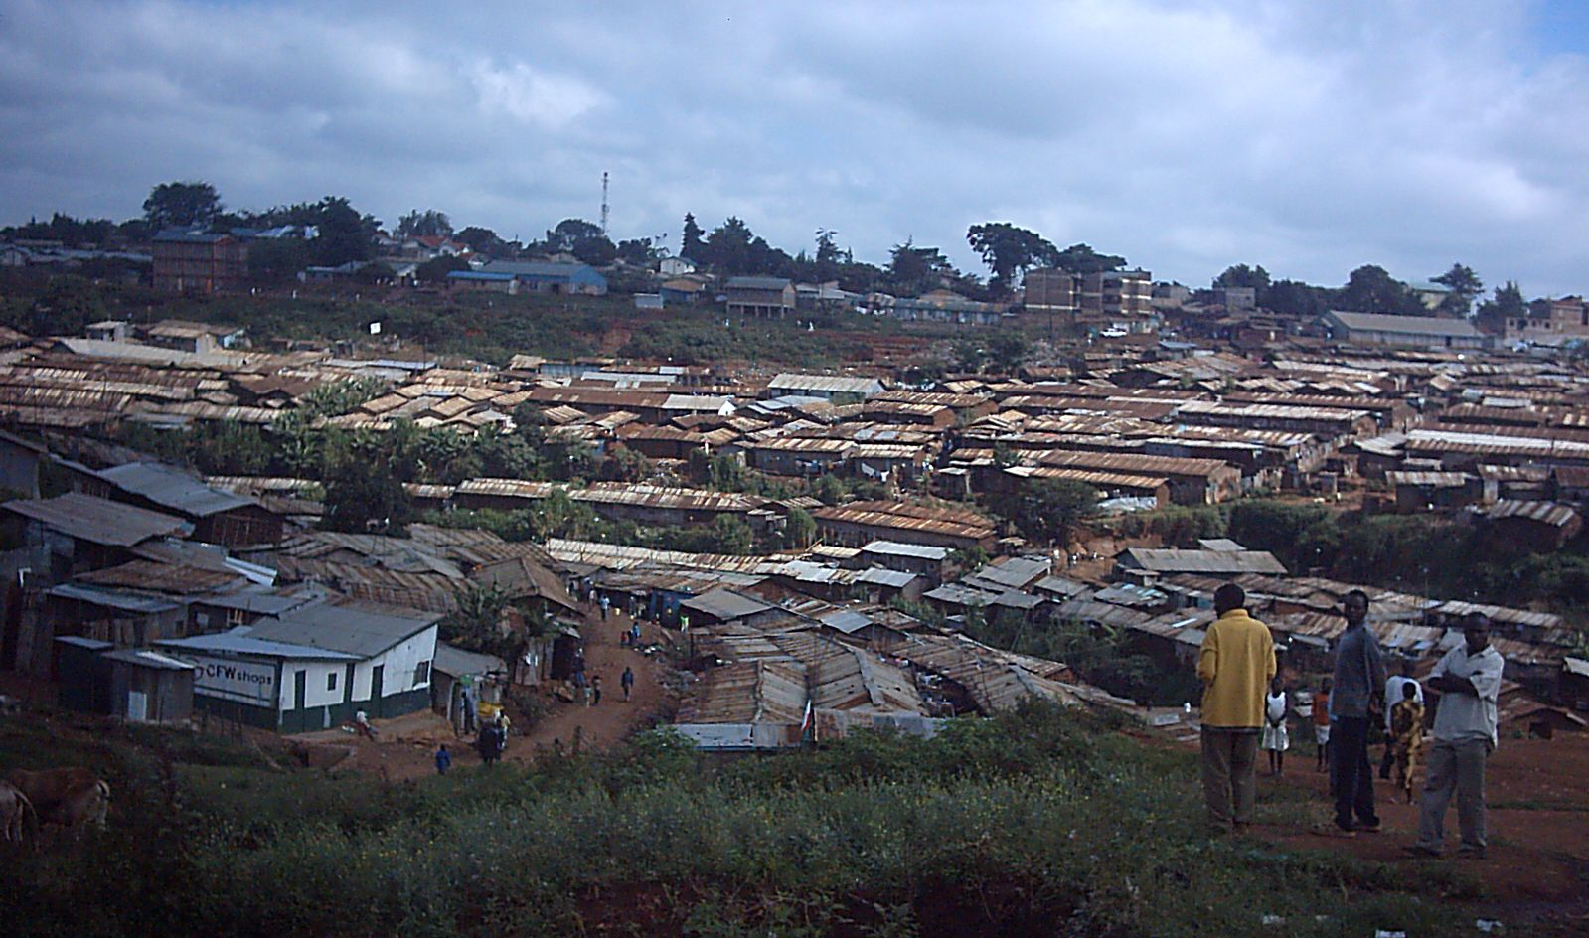
Context
Notes:
Sub-Saharan African Church: More than 80% of population Christian, Most churched continent, Most corrupt continent
Kibera – arguably Africa’s largest slum;
Saved, yes. Transformed?

Slide 3
Process
Kibera Pastors’ Network
Transformational conversations; story-telling approach
Global Conversation
City Conversation
Theological Conversation
Active Engagement

Slide 4
Ten Economic Principles
Love & Human Worth
Creativity
Productivity
Cooperation
Work and Rest
Simplicity
Redistribution
Management
Ownership
Celebration

Slide 5
Lessons Learned (and still learning…)
Appropriate training
Pricing
Power relations
Local Ownership and Participation

